Slide 1
Network Softwarization: Course Project Spring 2019
Fault Tolerant Software Defined Network Using OpenDayLight in SAVI Testbed
Manush Nandan Mohankumar (1004935314)
Shivani Sivashankar (1005324212)
University of Toronto
Youtube Link -https://youtu.be/zbBcjT8sdxY

Slide 2
Problem Statement
SDN is becoming prevalent in the networking domain and OpenDayLight is an advanced controller. With its many advantages, SDN still needs to be reliable and fault-tolerant. We intend to deal with this problem using an alternate way of performance in case of failure and analyzing the metrics while doing so.
AIM:
Getting our hands dirty with an important SDN controller - OpenDayLight
Creating a customized and more realistic network topology - Savi testbed
Discussing KPI used in networking layer which will affect user experience
Making the network reliable
Implementing back up for back up: Virtual tenant network

Slide 3
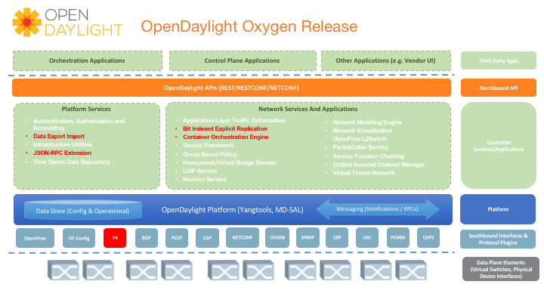
OpenDaylight Controller
Java based Open-source controller
Founded in 2013 with official release in 2014
Inspired from Beacon controller
Aim of eradicating “vendor-locking”
Provides high modularity and productivity
Key elements of ODL
MD-SAL
RESTCONF, NETCONF and YANG

Slide 4
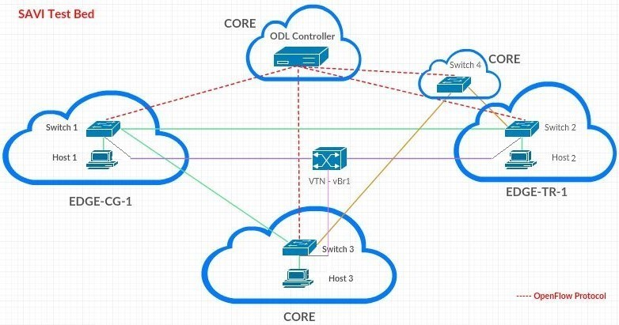
Proposed Scheme

Slide 5
When the network fails
Failure is the key to growth
Forcefully shut down a port
No L2 switching allowed, so no self-learning
Test for loss of packets
Ensure alternate flow rules are injected automatically: creation of new path

Slide 6
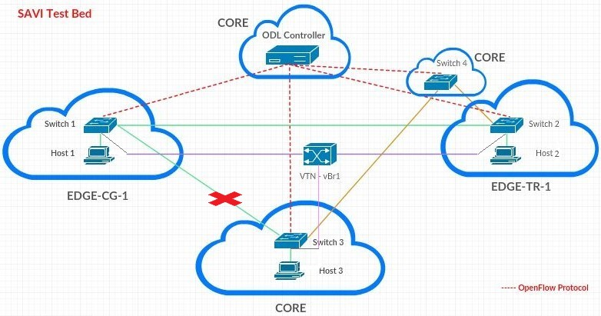
Fault condition in the proposed scheme

Slide 7
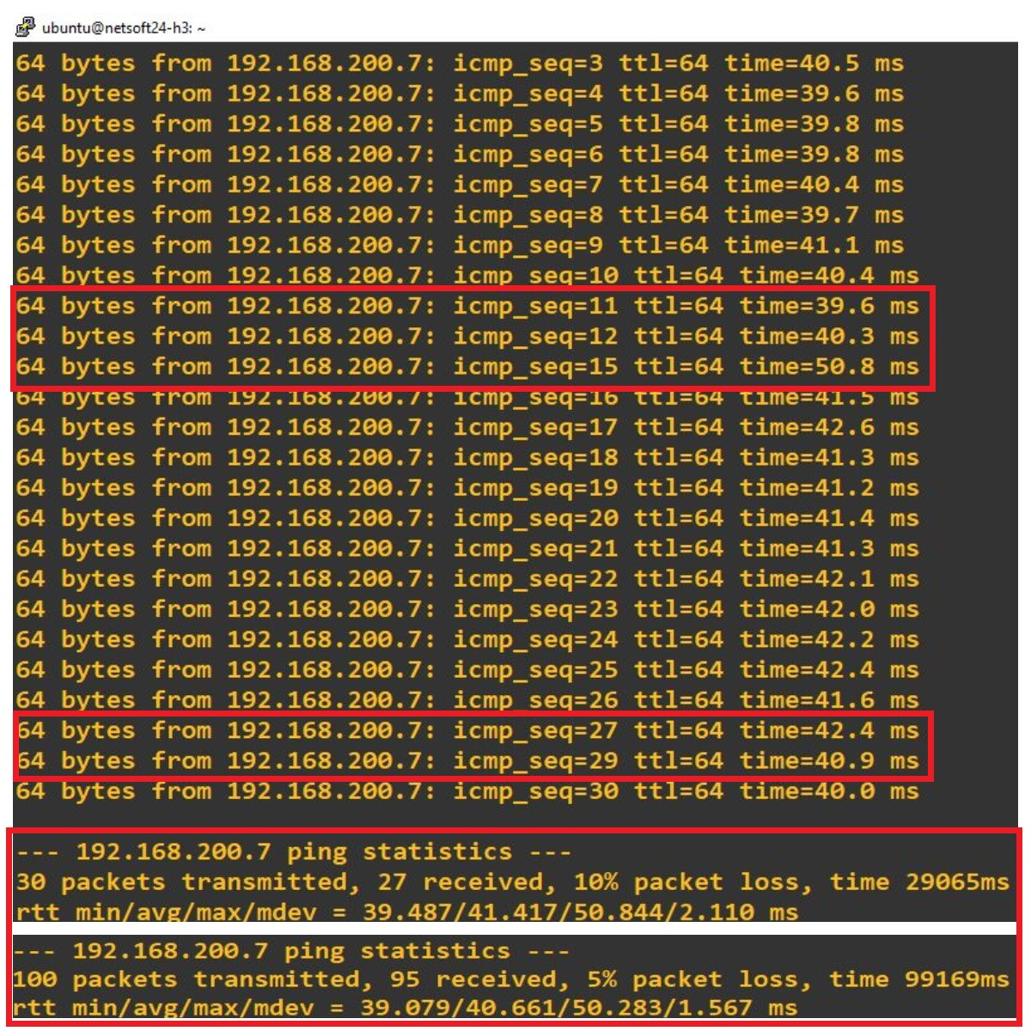
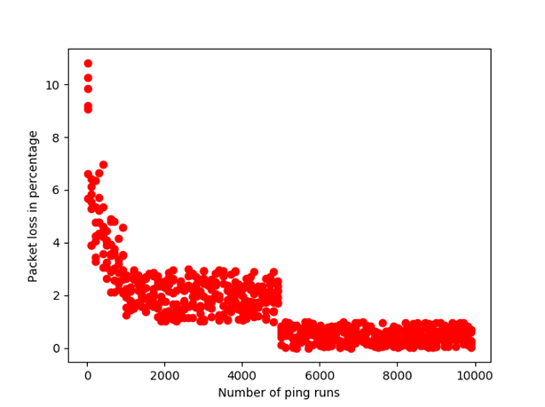
Fault tolerant ping between hosts
Fault condition - Switch 3 Port 2 No-Forward
Alternate routes using back up switch 4
Once, fault is resolved flows are through original route
Assume one kind of failure happens once
What if controller fails to connect to its network?

Slide 8
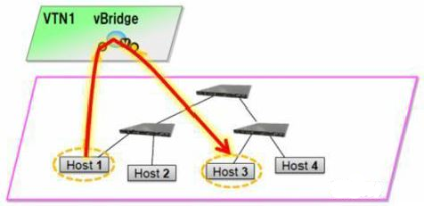
Virtual Tenant Network
Condition - Flows disappears after hard-time out in all the switches. Switch 4 is not used in this case.
Deployment of VTN using virtual bridges and VLAN interfaces which are connected to the host contact ports of the switches
VTN maps with underlying infrastructure and produces L2 switching forming logical abstraction plane.

Slide 9
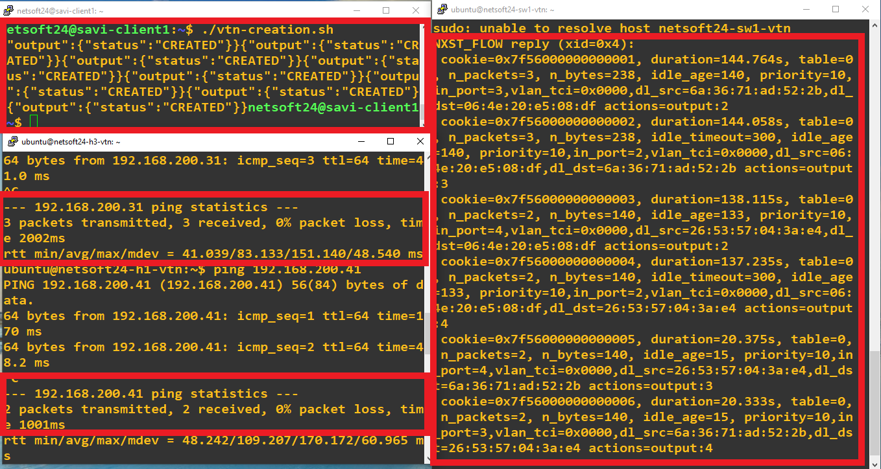
Virtual Tenant Network Contd.

Slide 10
Conclusion and Summary
A custom topology has been created on Savi testbed over a spanning geography
On failure of network and no capability to self-learn, alternate rules were automatically deployed
Metrics analysis was performed to evaluate the vulnerability of the network on failure
If the fault is on the controller side or the plugIn between the SDN-C and data plane, VTN can be deployed
We can conclude that a custom SDN has been made reliable, resilient and fault-tolerant

Slide 11
Future Works
What can VTN achieve?
With no OpenFLow plugIn, flows can still be injected and used
It will take the shortest path calculated and not beat about the bush
Mapping can be modified by user-defined policies
Can be used for service chaining and filtering
Security can be modified

Slide 12
Future Works Contd.
On scaling the network, we need better ways to tackle the quality performance
Orchestration will ensure self-healing and coherence: LSO UniMgr
LSO Presto and Legato used to orchestrate between Application-Control-Data planes
Automation will handle huge data and complex application
ONAP can assess and allocate resources as and when needed and optimize the usage

